Slide 1
Human Anatomy and Physiology
Chapter 1

Slide 2
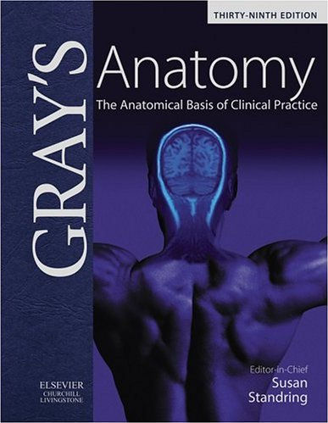
Anatomy
The study of internal and external structure and the physical relationships between parts
Greek for separate or cut open

Slide 3
Macroscopic (Gross) Anatomy
Deals with features that are visible with the naked eye
Surface anatomy – The study of the general form and superficial markings
Regional anatomy – The study of the superficial and internal features in a specific region of the body. Ex. head, neck, or trunk
Systemic anatomy – The study of features of major organ systems. Ex. The cardiovascular system
Notes:
Don’t worry we will talk more about organ systems

Slide 4
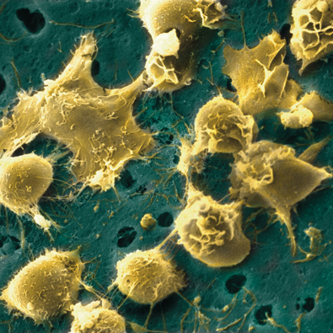
Microscopic Anatomy
Deals with features that are not visible with the naked eye
Cytology – analyzes the internal structure of individual cells
Histology – analyzes tissues or groups of specialized cells
Notes:
Discuss electron microscopes and light microscopes, test class for differences, this is bone marrow cells

Slide 5
Physiology
Studies the functions of the anatomical structures
Cell Physiology – The study of the function of living cells, includes events at the chemical level within and between cells.
Special Physiology – Study of the function of a specific organ
System Physiology – The study of the function of organ systems
Pathological Physiology – Studies the effects of diseases on organ or system functions
Notes:
Kidney – Renal phs and Heart = cardiac, pathos is Greek for disease, test for difference between phys and anat

Slide 6
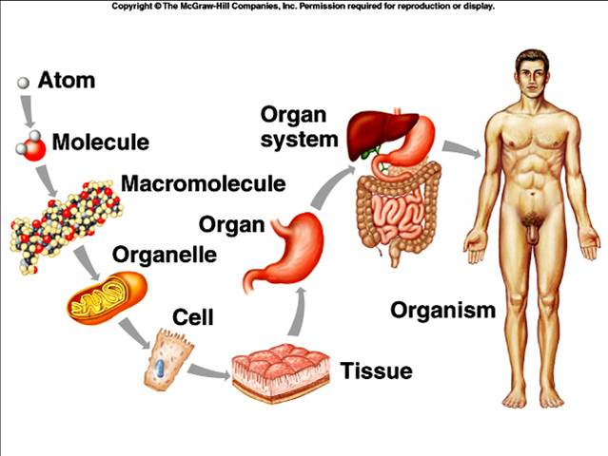
Levels of organization

Slide 7
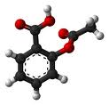
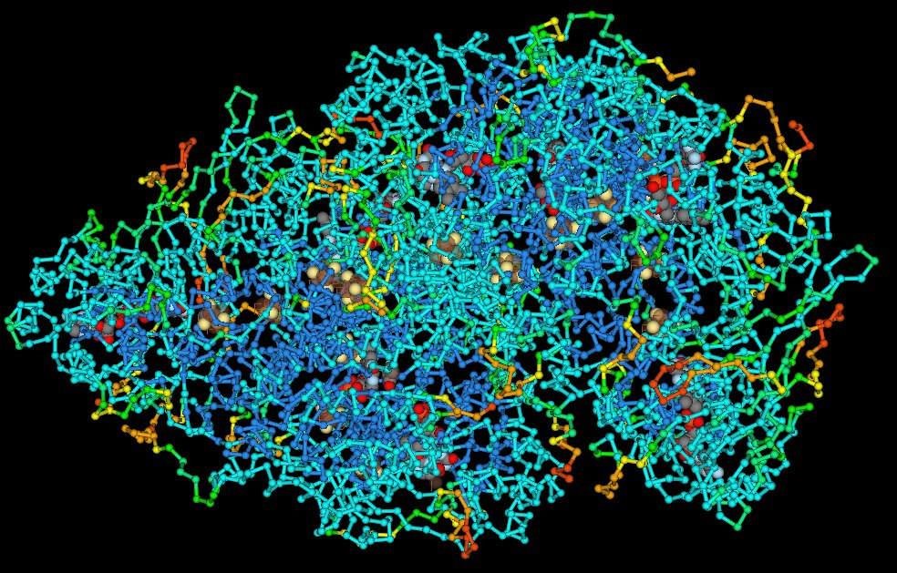
Up and Atom
Subatomic particles are the smallest known building block
Atoms are the most basic building block of all matter
Put a bunch of atoms together and presto, you have a molecule with different properties than the atom.
Put some molecules together and you get a macromolecule
Notes:
Discuss how atoms contain all of the properties of the substance that they make up., this is aspirin, talk about DNA, proteins are usually macromolecules

Slide 8
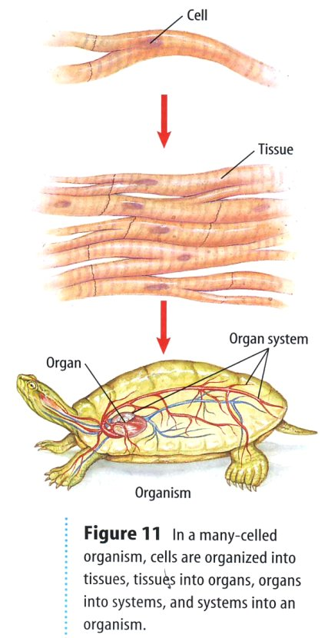
To the living stuff
These macromolecules form an organelle, which is basically an organ for a cell
Cells usually have a specific job, when these cells get together they form tissue
When groups of tissue get together they form an organ, which also has specialized functions

Slide 9
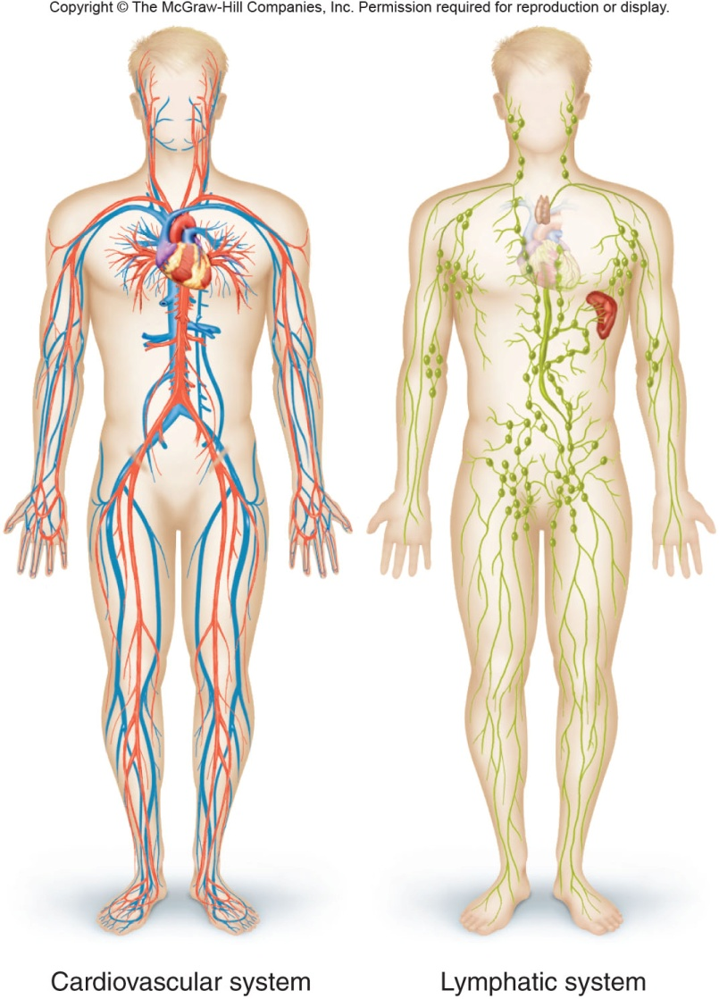
Almost there
A group of organs that help do the same job form an organ system
Ex. Your circulatory system
All the organ systems combine to create a full functioning human being

Slide 10
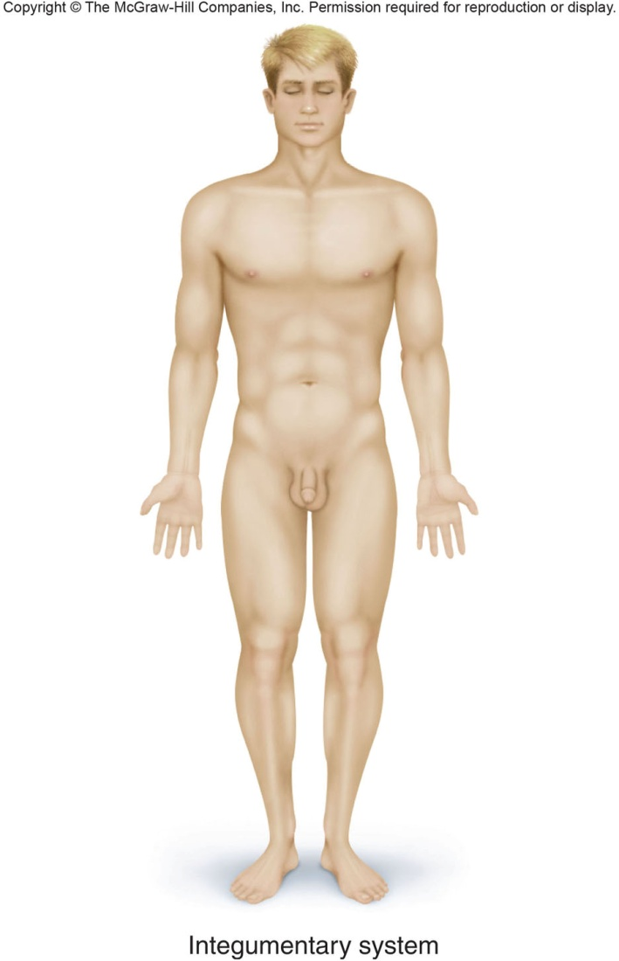
Integumentary System
Includes: the skin, hair, nails, and other accessory organs
Protects tissues
Regulates temperature
Houses sensory receptors

Slide 11
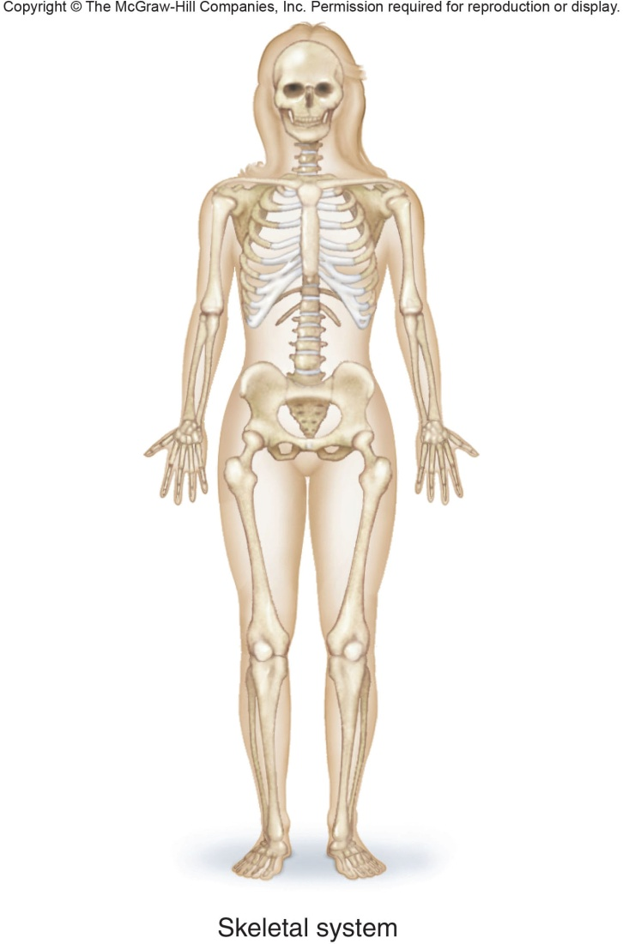
Skeletal System
Includes: bones, cartilage, and ligaments
Provide framework
Serve as attachments for muscles
Some tissues produce blood

Slide 12
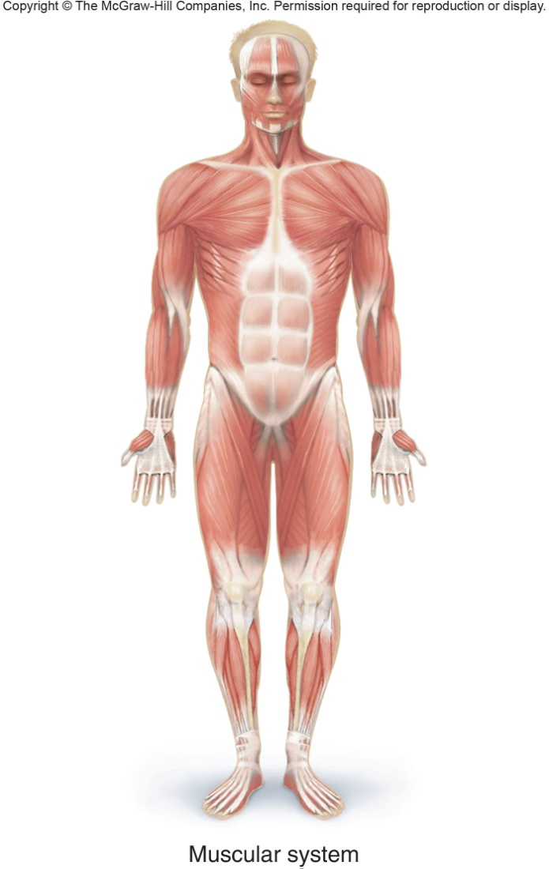
Muscular System
Includes: muscles
Provide movement
Maintain posture
Produce body heat

Slide 13
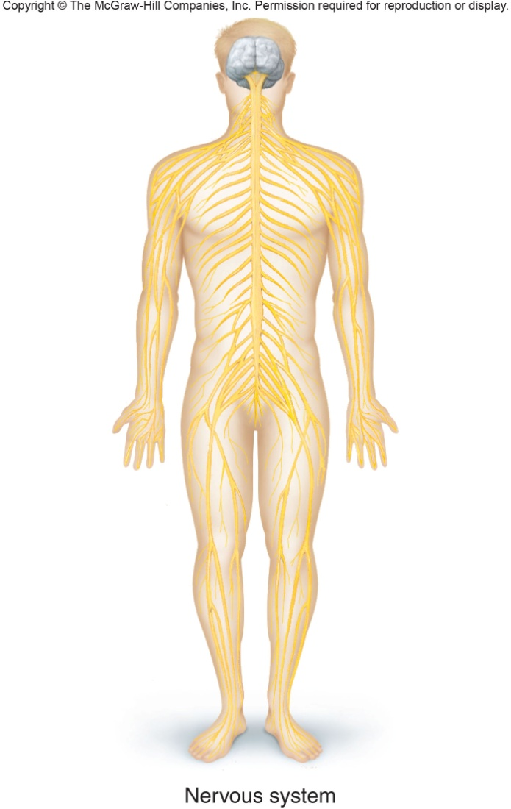
Nervous System
Includes: brain, nerves, spinal cord, and sense organs
Use electrochemical signals called nerve impulses
Allows for communication between other parts of the body

Slide 14
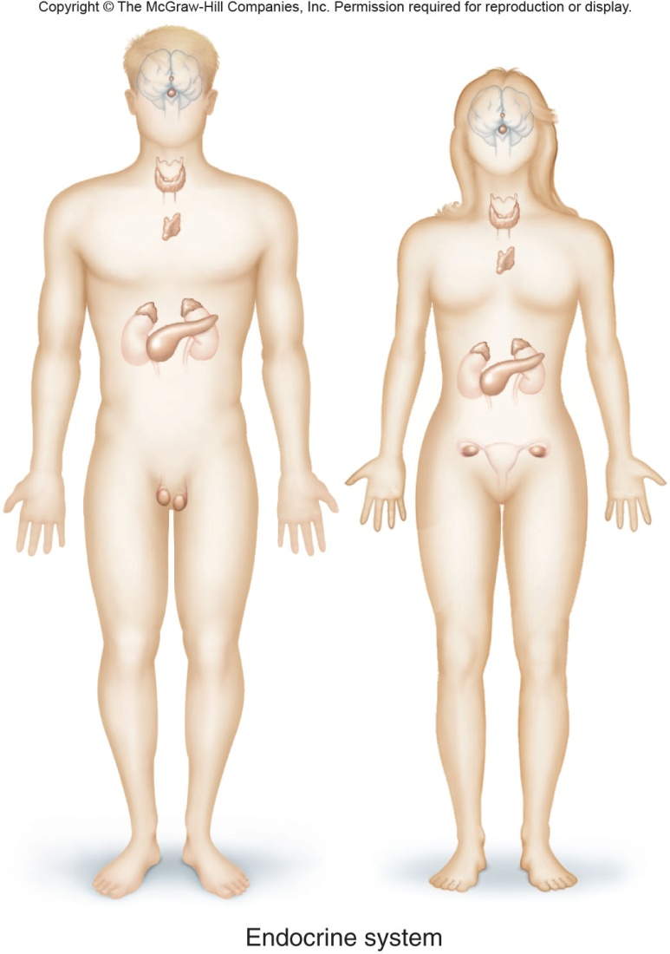
Endocrine System
Includes: Glands that secrete chemical messengers called hormones
Allows for body changes that last for a long time

Slide 15
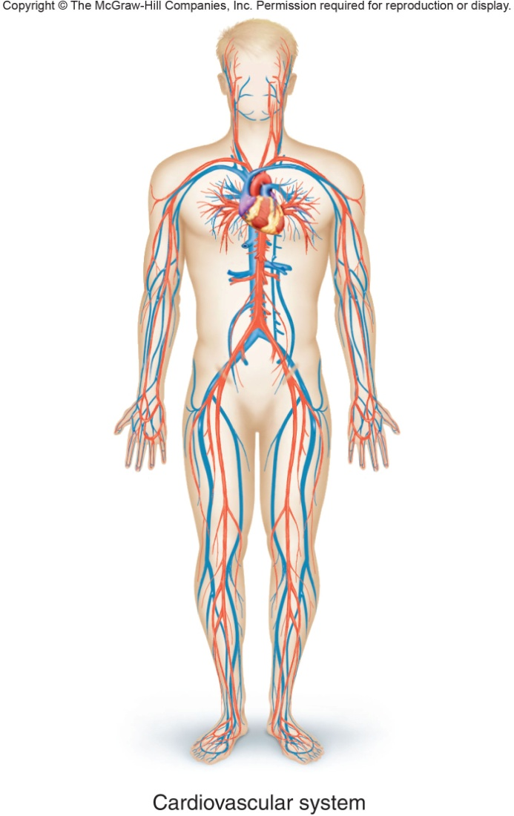
Cardiovascular System
Includes: heart, arteries, veins, capillaries, and blood
Transports wastes, gases, nutrients, hormones

Slide 16
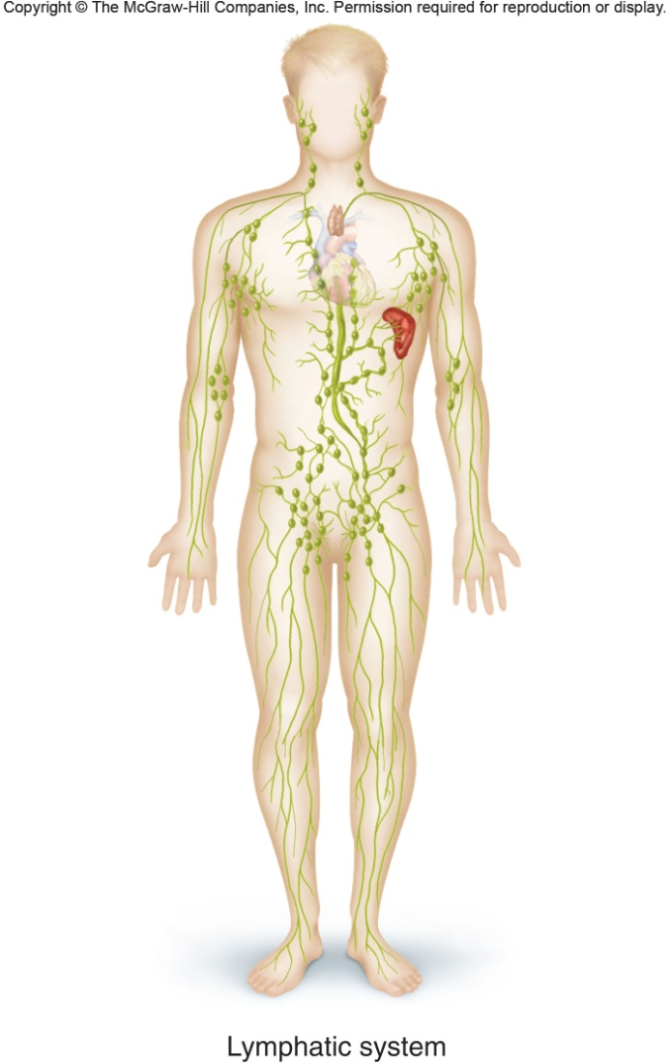
Lymphatic System
Includes: Lymphatic vessels, Lymph Fluid, Lymph nodes, Thymus, and Spleen
Transports tissue fluid to blood
Carries fatty substances away from digestive organs
Defends against disease
Notes:
Sometimes seen as part of the cardiovascular system

Slide 17
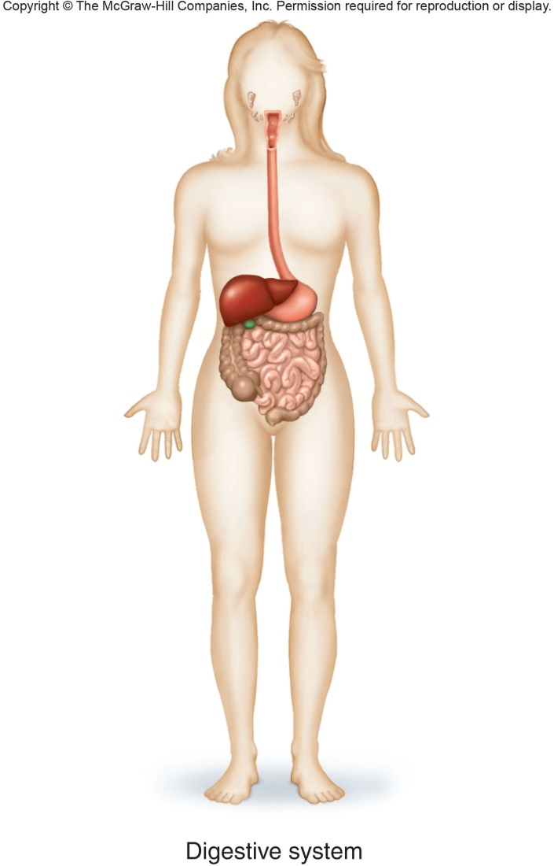
Digestive System
Includes: mouth, tongue, teeth, salivary glands, pharynx, esophagus, stomach, liver, intestines, gallbladder, and pancreas
Breaks down food into pieces that can be used by the body

Slide 18
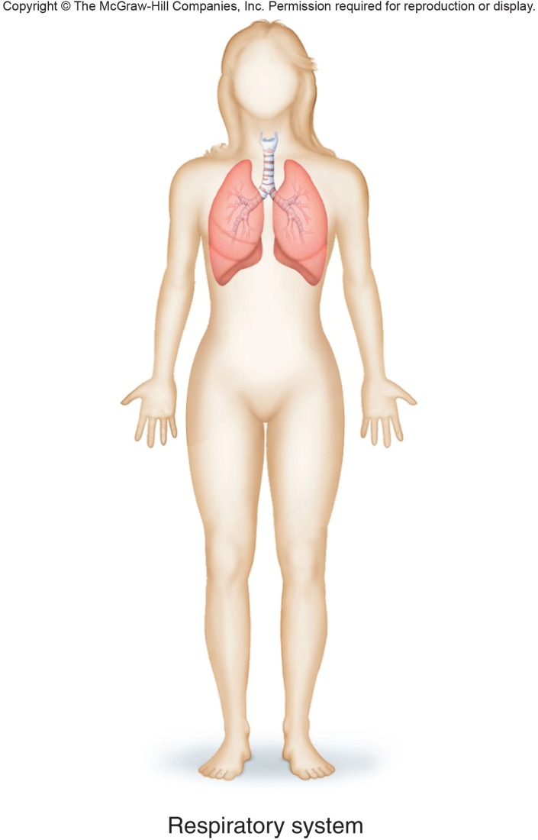
Respiratory System
Includes: nasal cavity, lungs, bronchi, pharynx, larynx, and trachea
Provides oxygen
Gets rid of Carbon Dioxide

Slide 19
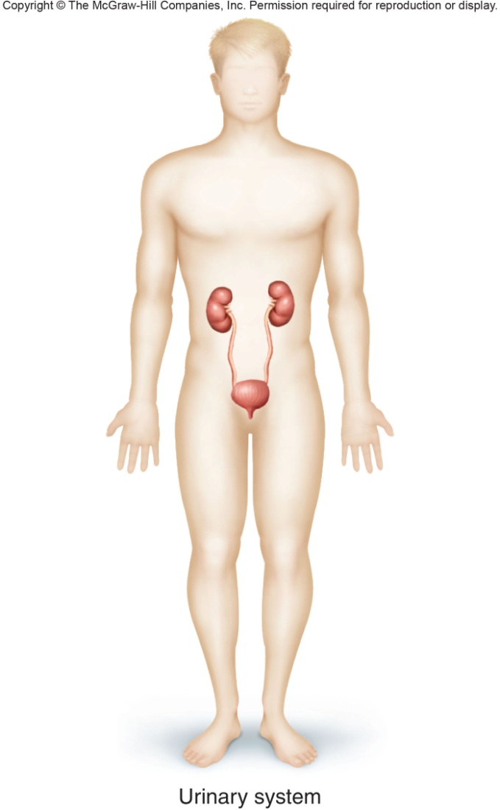
Urinary System
Includes: kidneys, ureters, urinary bladder, and urethra
Gets rid of nitrogenous waste or urine
Digestive + Urinary = Excretory System

Slide 20
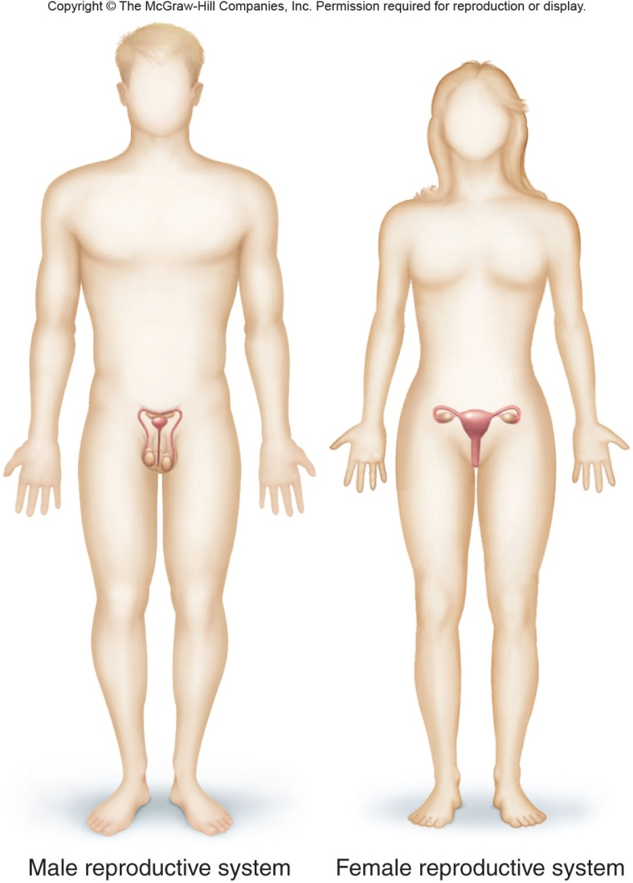
Reproductive System
Includes: More parts than any other system on page 18
Manufactures and transports sex cells aka sperm and eggs

Slide 21
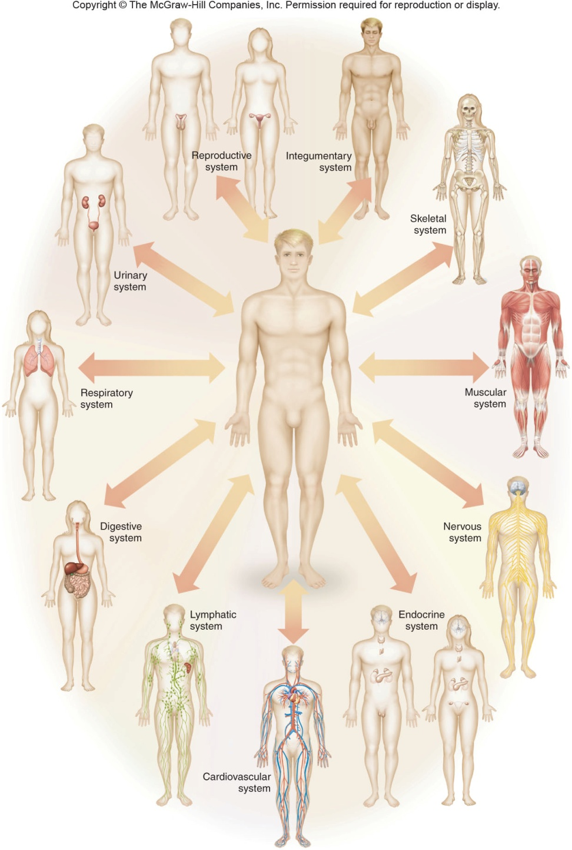

Slide 22
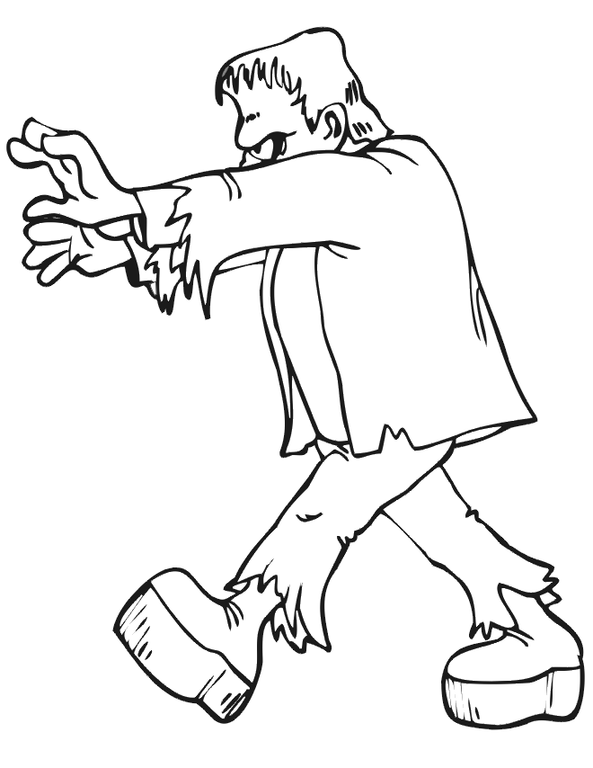
Characteristics of life
Responsiveness
Growth
Reproduction
Movement
Metabolism

Slide 23
Responsiveness
Organisms respond to changes in their environment
Also known as irritability or adaptation
Can be long term or short term
Ex. Being afraid of someone jumping out at you
Ex. Animals that grow thicker coats during winter

Slide 24
Reproduction
The ability of an organism to create generations of similar organisms
Movement
Can be internal – The movement of food, blood or other materials
Can be external – moving through the environment

Slide 25
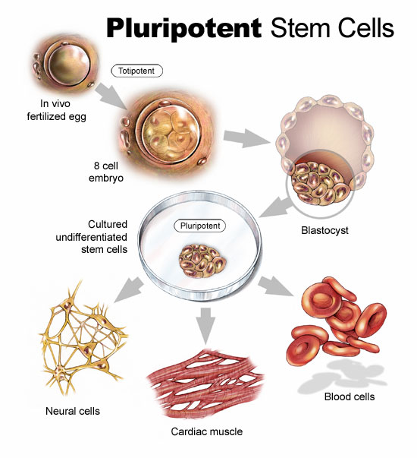
Growth
Characterized by increasing the number of cells or increasing the size of cells.
Differentiation – when individual cells become specialized
Notes:
Rotifers stay same size forever but increase cell number, humans do both, stems cells to other cells.

Slide 26
Metabolism
All chemical operations that occur in the body
Provides energy for the other characteristics
Usually creates waste products that the body gets rid using the process called excretion
Respiration – the absorption, transfer, and use of oxygen by the cells
Notes:
Bring up fast and slow metabolism, small organisms just absorb many of their materials while humans cannot, but humans have specialized organs for many of their metabolism.

Slide 27
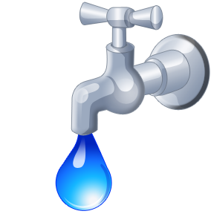
What we require to live
Water
  required for metabolic processes
  most abundant substance in body
  required for transport of substances
  regulates body temperature
Notes:
Discuss how water is used to cool and heat body, adult males are 60% and babies are up to 75%

Slide 28
More of what we need
Oxygen (gas)
  one-fifth of air
  used to release energy from nutrients
Food
  provides necessary nutrients
  supplies energy
  supplies raw materials

Slide 29

The last of what we need
Heat
  form of energy
  partly controls rate of metabolic reactions
Pressure
  application of force on an object
  atmospheric pressure – important for breathing
  hydrostatic pressure – keeps blood flowing

Slide 30
Homeostasis
The body’s maintenance of a stable internal environment
The body uses 3 homeostatic mechanisms to maintain internal environment
  Receptors – provide information about specific conditions and can be a cell or molecule
  Control center – has a set point that tells what a particular value should be
  Effectors – These actually change the environment and can be glands or muscles
Notes:
Internal environment prevents cells from dying using the extracelleur fluid, bring up temperature

Slide 31
A quick example
Think of the thermometer in your house as a receptor
Your thermostat is your control center & what you set it at, is your set point
Your heater is your effector that begins running to heat your house
Notes:
Hypothalmus is the control center for humans,

Slide 32
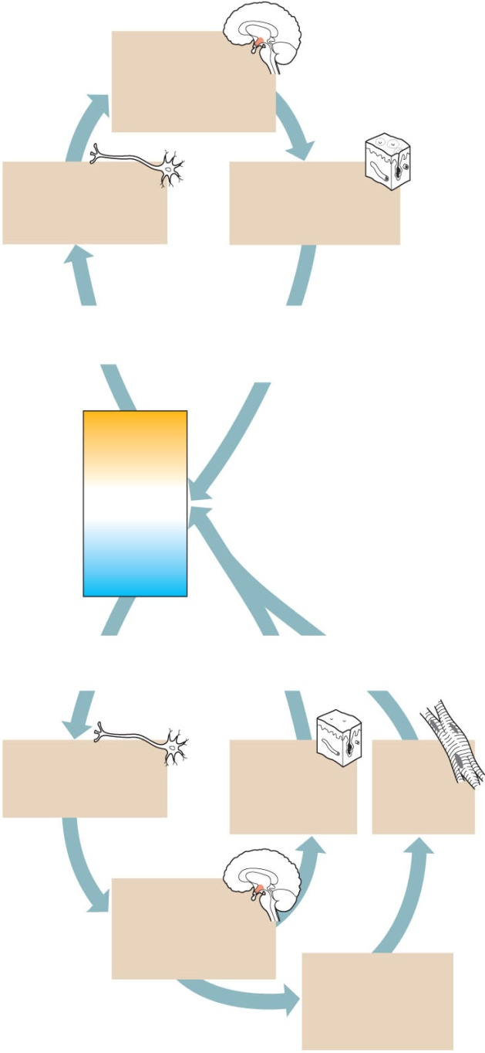
Control center
The hypothalamus
detects the deviation
from the set point and
signals effector organs.
Receptors
Thermoreceptors
send signals to the
control center.
Effectors
Skin blood vessels
dilate and sweat glands
secrete.
Stimulus
Body temperature
rises above normal.
Response
Body heat is lost to
surroundings, temperature
drops toward normal.
too high
Normal body
temperature
37°C (98.6°F)
too low
Stimulus
Body temperature
drops below normal.
Response
Body heat is conserved,
temperature rises toward normal.
Receptors
Thermoreceptors
send signals to the
control center.
Effectors
Skin blood
vessels constrict
and sweat glands
remain inactive.
Effectors
Muscle
activity
generates
body heat.
Control center
The hypothalamus
detects the deviation
from the set point and
signals effector organs.
If body temperature
continues to drop,
control center signals
muscles to contract
Involuntarily.

Slide 33
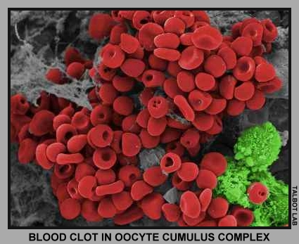
Types of feedback mechanisms
Negative Feedback – this causes the effectors to slow down or stop as conditions return to normal
Positive Feedback – short lived reactions that cause unstable conditions and move the body away from normal state
Notes:
Is blood clotting positive or negative feedback? Discuss what it means to be normal

Slide 34
Organization of the human body
Two main portions
  Axial portion which includes head, neck, and trunk
  Appendicular portion which includes all of your limbs

Slide 35
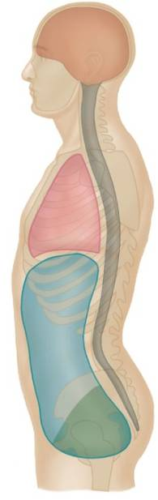
Cavities In the Axial portion
Cranial cavity
Vertebral canal
Thoracic cavity
Abdominopelvic cavity
  Composed of the abdominal and pelvic cavities
The organs in the thoracic and abdominal are called viscera
Cranial cavity
vertebral canal
Thoracic cavity
Abdominal
cavity
Abdominopelvic
cavity
Pelvic cavity
Notes:
Discuss oral, nasal, orbital, and middle ear cavities of the head

Slide 36
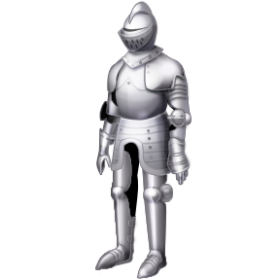
Insane in the Membranes
Serous Membranes – membranes that line a cavity
  Have two layers with mucus in between
  The parietal is the layer the lines the wall
  The visceral is the layer that surround the organ
Notes:
Body armor for organs

Slide 37
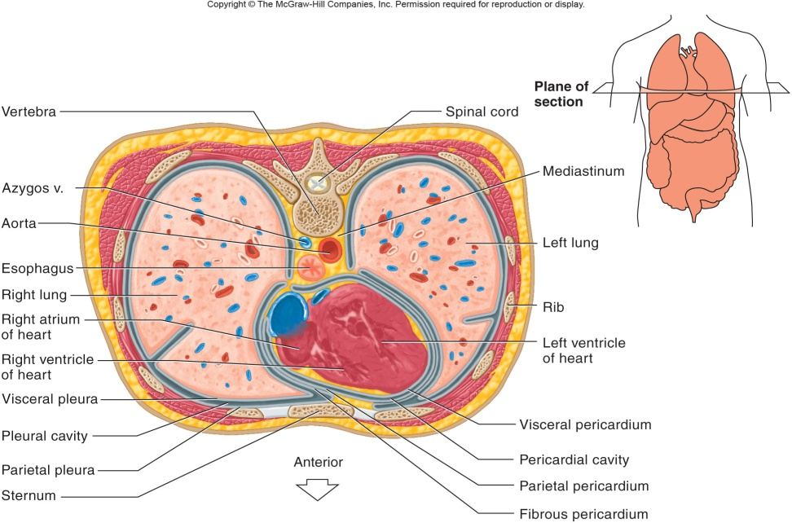
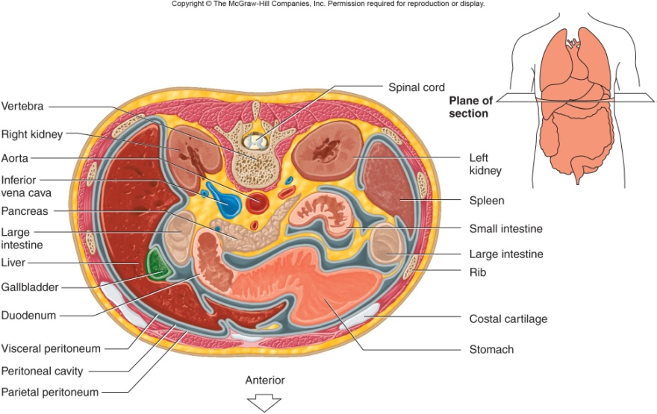
Abdominopelvic membranes
Pleural membranes
  surrounds the lungs
Pericardial membranes
  surround the heart
  Has visceral, parietal, and fibrous layers
Peritoneal membranes
  Line the walls of the abdominopelvic cavity

Slide 38
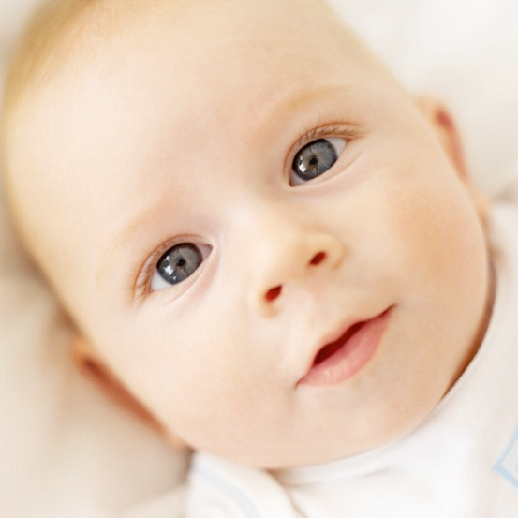
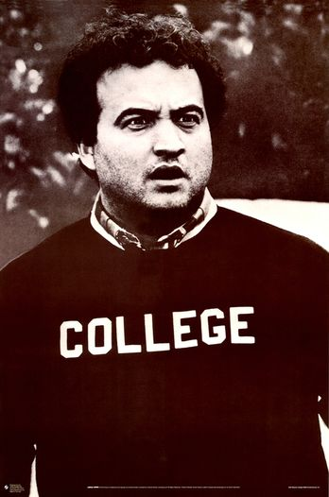
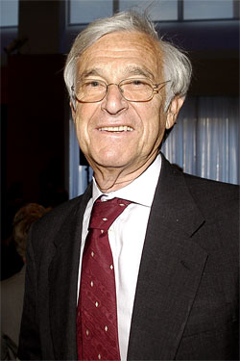
Aging
What does it mean to you?
Think
Pair
Share

Slide 39
Anatomical Terminology
Anatomical Position – standing erect, facing forward, upper limbs at the sides, palms facing forward and thumbs out

Slide 40
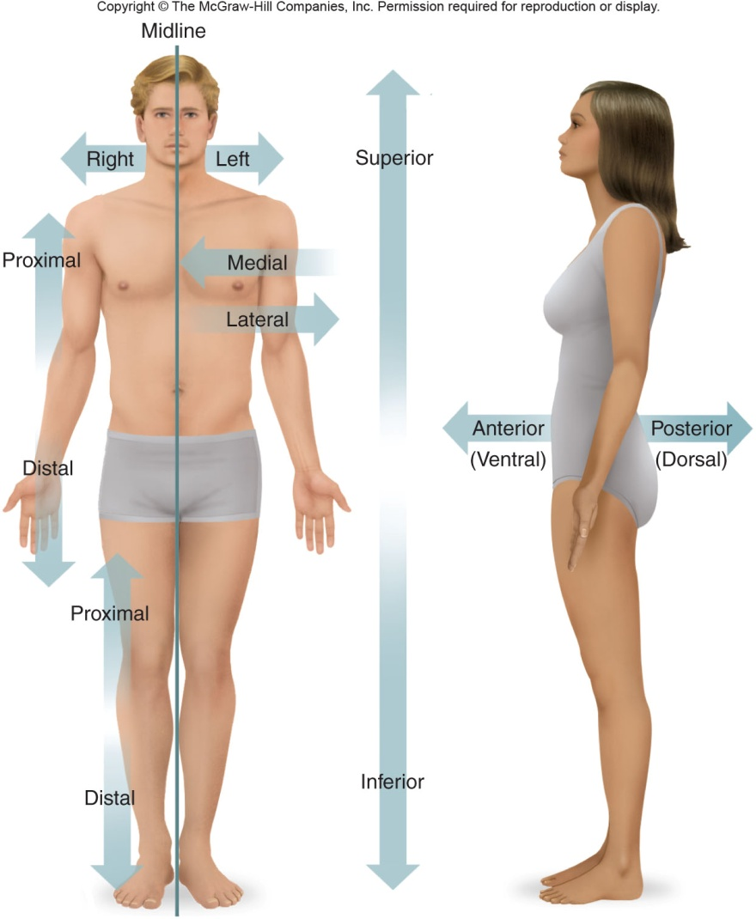
Relative Position
Superior v. Inferior
  Superior – Closer to the hear
  Inferior – closer to the feet
Anterior v. Posterior
  Anterior – towards the front
  Posterior – toward the back

Slide 41
Relative Postition
Ipsi-lateral v. Contra-lateral
  Ipsi-lateral – structures that are on the same side
  Contra – lateral – structures on opposite sides
Medial v. Lateral
  Medial - closer to your midline, that goes from your nose to your bellybutton
  Lateral – closer to your arms
  Bilateral – paired structures with one on each side

Slide 42
Relative Position
Proximal v. Distal
  Proximal – closer to the trunk as compared to another structure
  Distal – farther from the trunk
Superficial v. Deep
  Superficial – closer to the surface also known as peripheral
  Deep – more internal

Slide 43
Body Sections
Sagittal or Median – divides body into left and right portions
  Mid-sagittal – divides body into equal left and right portions
Transverse or Horizontal – divides body into superior and inferior portions
Coronal or Frontal – divides body into anterior and posterior portions

Slide 44
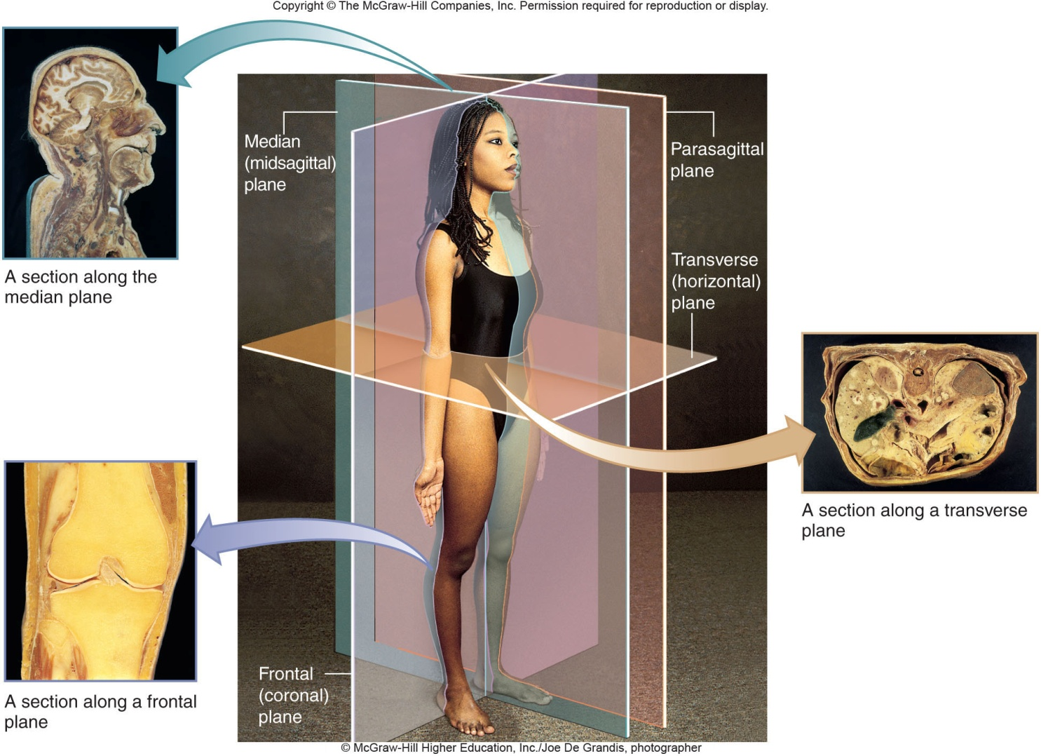
Body Sections

Slide 45
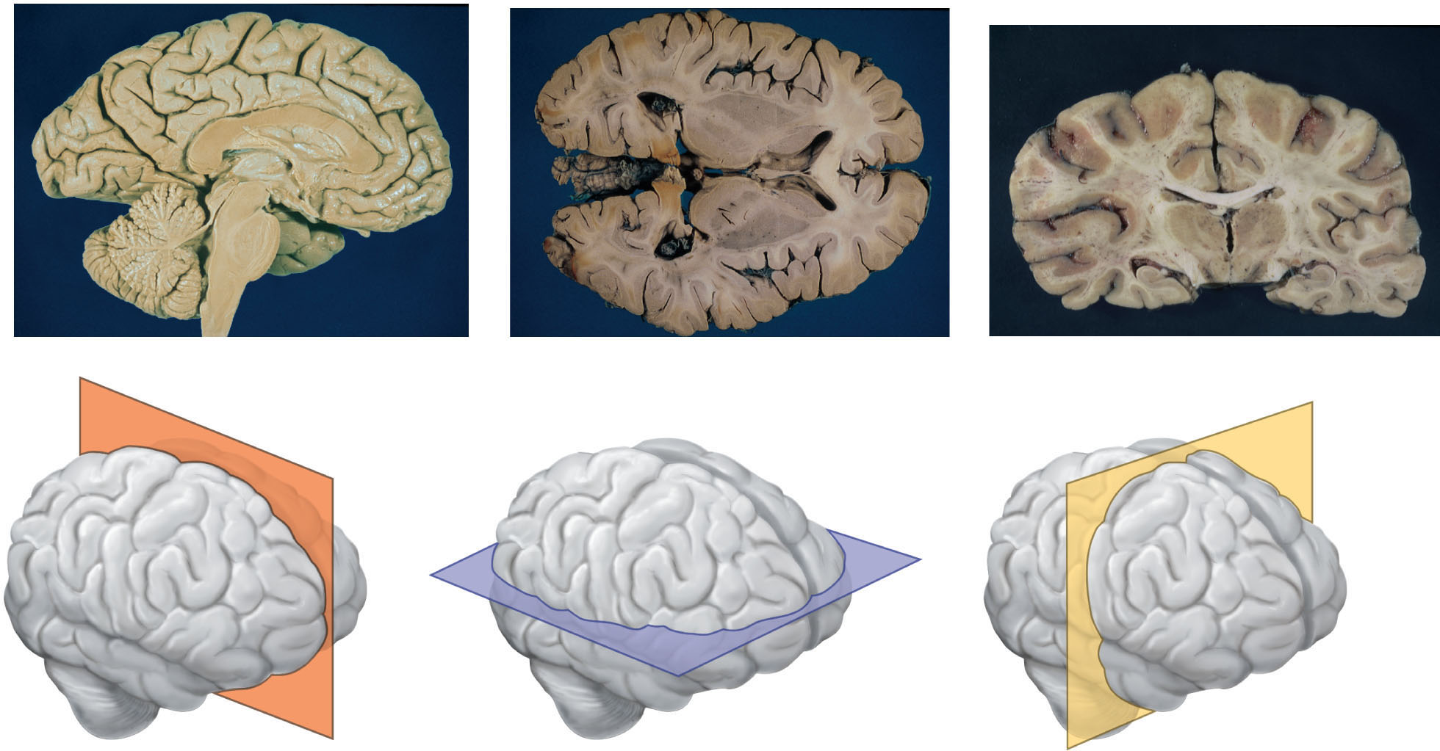
Body Sections
Notes:
Sagittal, transverse, frontal

Slide 46
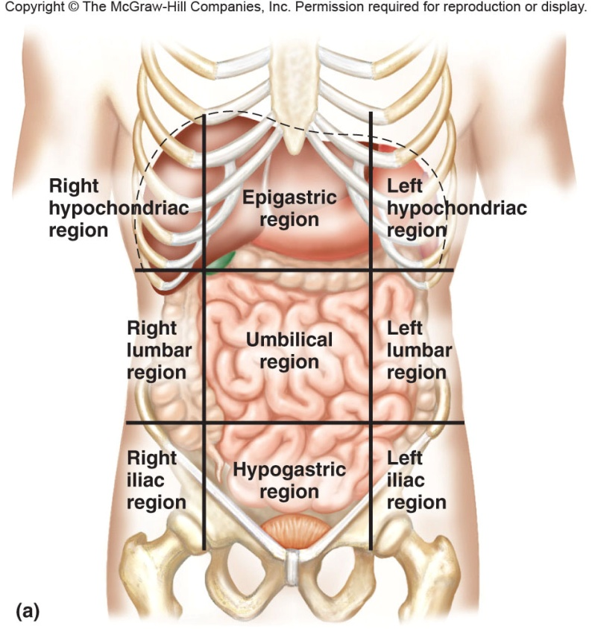
Body Sections
Know the nine regions

Slide 47
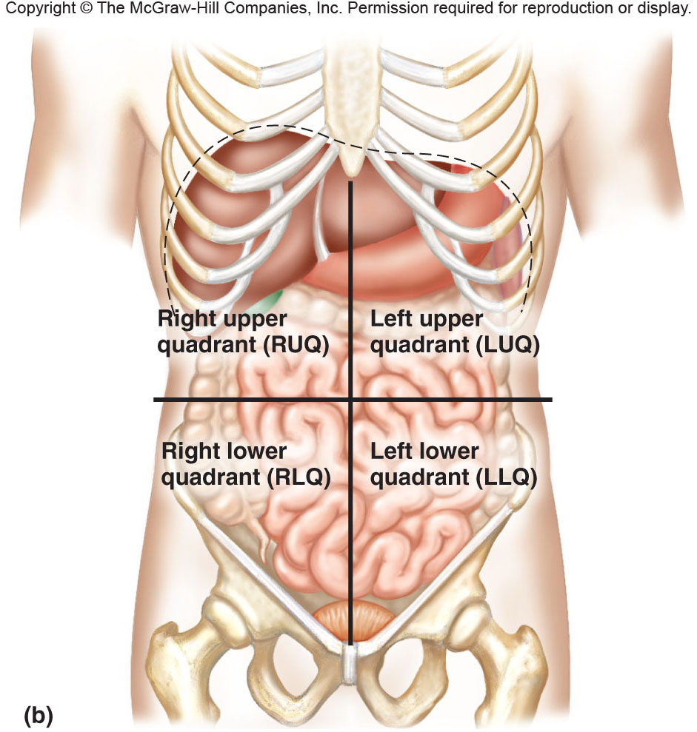
Body Sections
And four quadrants and abbreviations

Slide 48
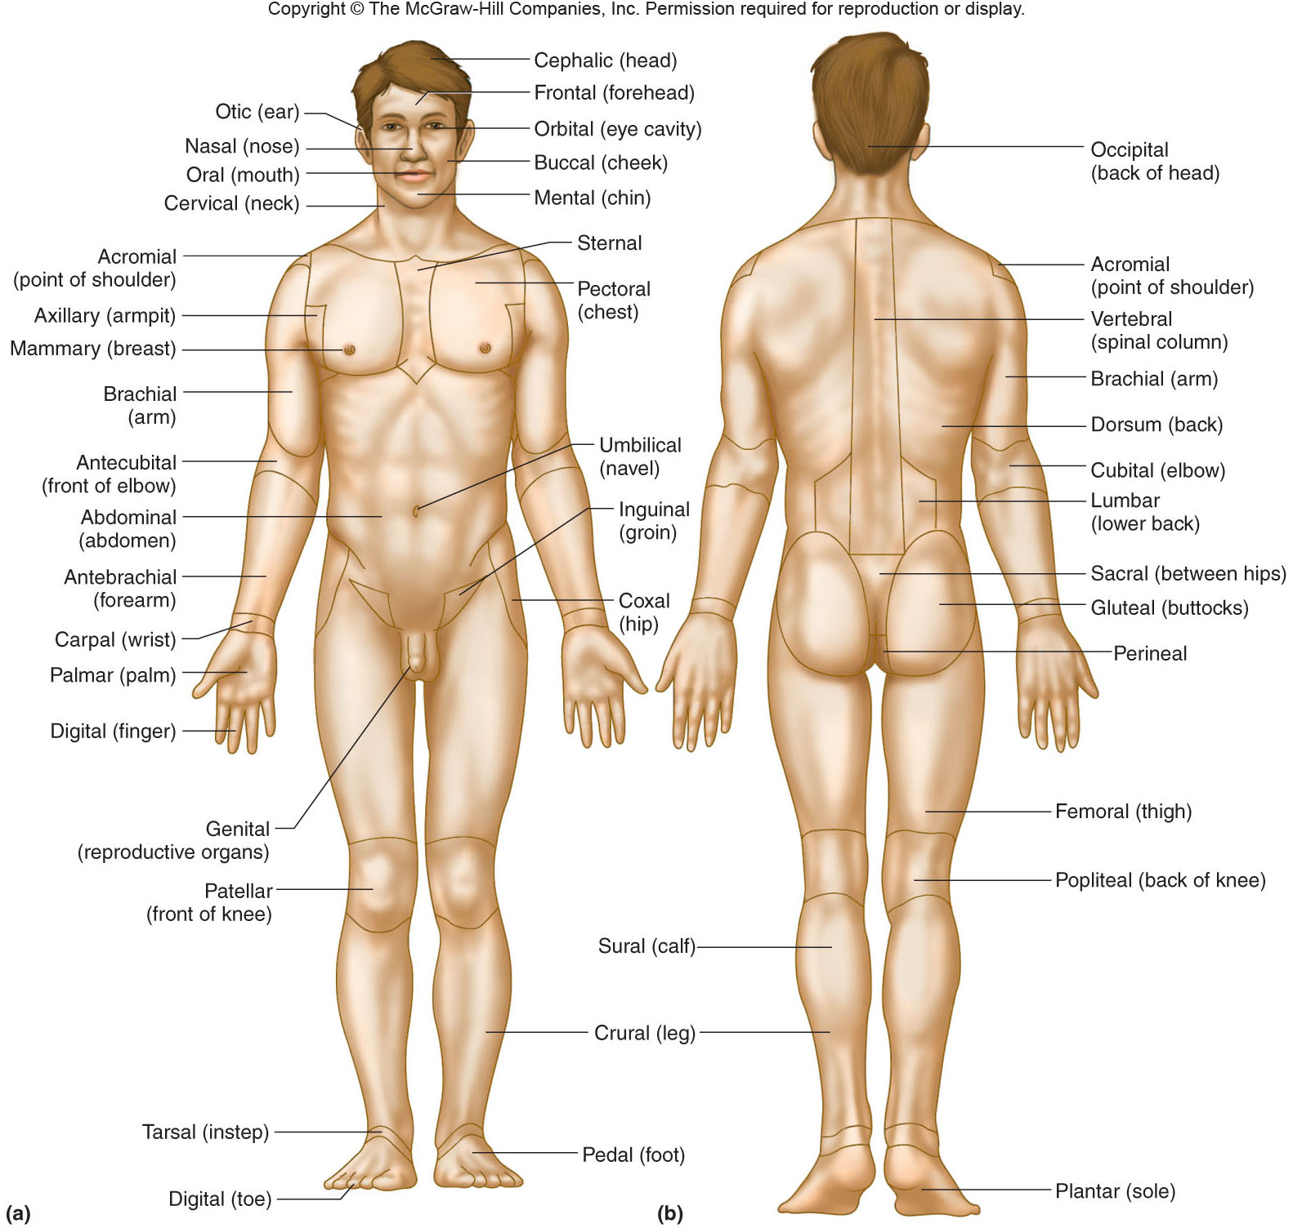
Body Regions
Turn to p. 23

