Slide 1
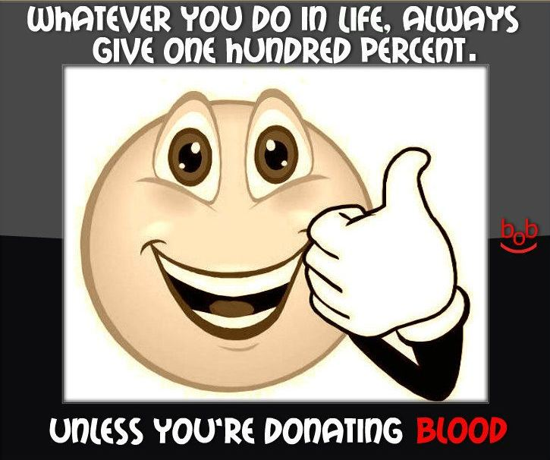
Blood
Chapter 12: A Bloody Good Time

Slide 2
https://www.youtube.com/watch?v=Futnu_6NmQo

Slide 3
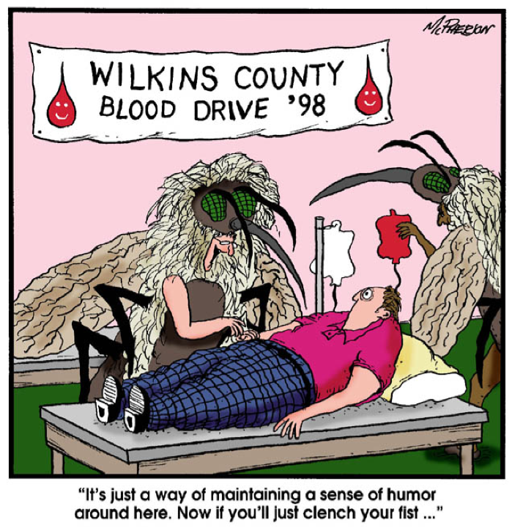
Phlebotomist
person trained to draw blood from a patient for clinical or medical testing, transfusions, donations, or research.

Slide 4
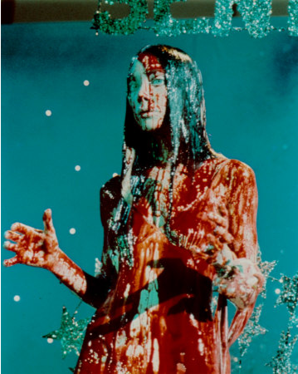
Basic Functions
Transports substances throughout the body to maintain homeostasis
Fun Fact: Hematophobia = Fear of blood

Slide 5
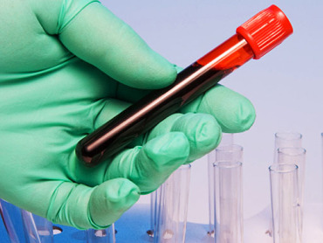
Blood Cells
Blood is connective tissue
Cells(rbc, wbc, and platelets) – 45%
Plasma (water, proteins, amino acids, etc) = 55%

Slide 6
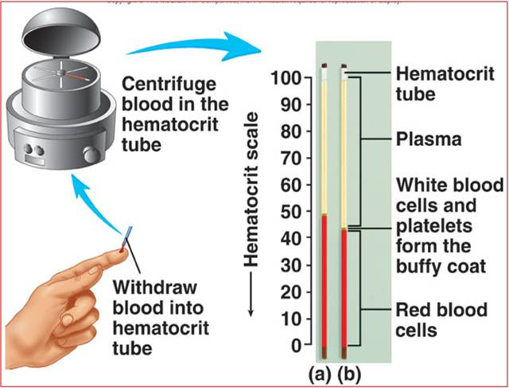
Hematocrit
The percentage of red blood cells in a given sample of blood
Normally 45% blood/55% plasma
Determined by placing blood in a centrifuge

Slide 7
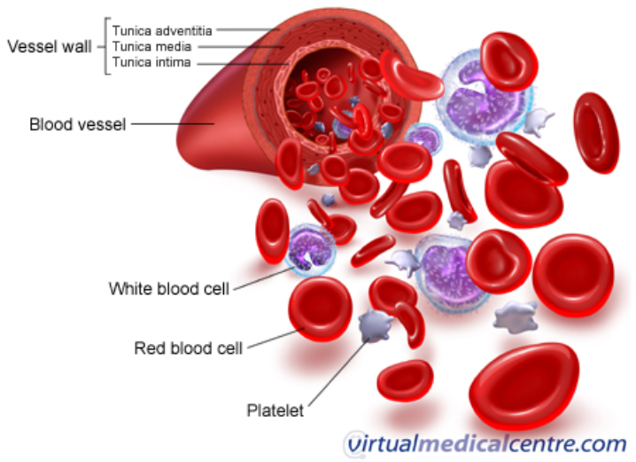
Types of blood Cells
erythrocytes = red blood cells
leukocytes = white blood cells
thrombocytes= platelets

Slide 8
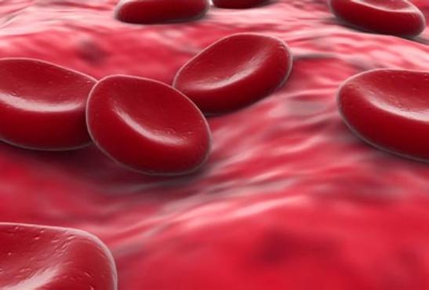
Its as easy as RBC
Shaped like a biconcave disc
5,000,000 per cubic mm
Lacks a Nucleus
Cannot divide on their own

Slide 9
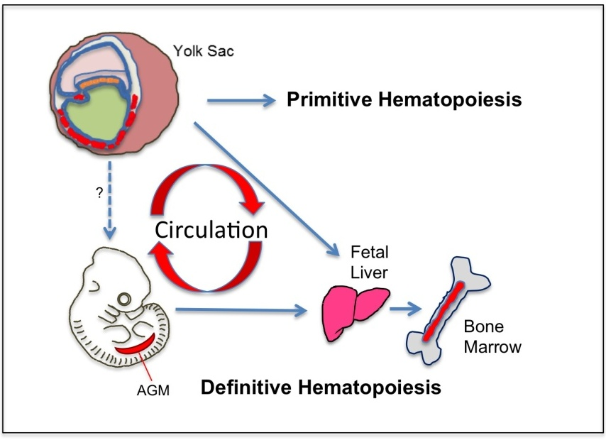
Hematopoeisis
Formation of blood cells
Occurs in the bone marrow
Old blood cells are destroyed by the liver and spleen by phagocytosis

Slide 10
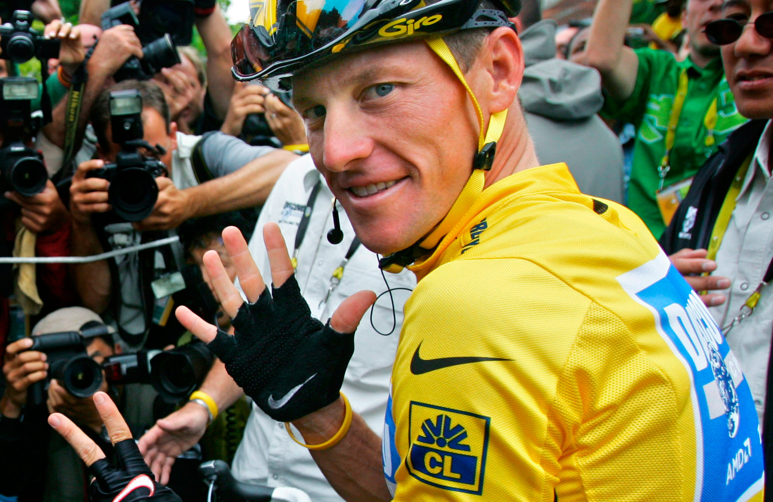
EPO
EPO, or erythropoietin, is a hormone that increases production of RBC’s.

Slide 11
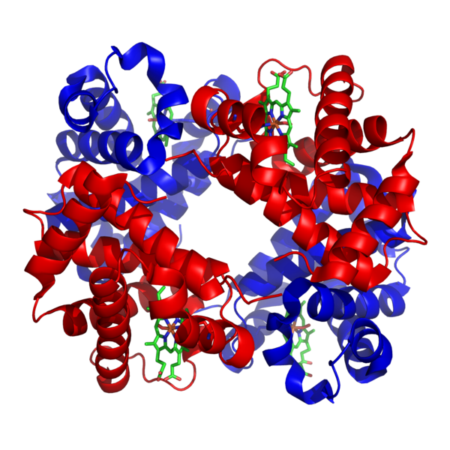
RBC Functions
Transports oxygen, remove carbon dioxide
HEMOGLOBIN - molecule that combines with O2
IRON is critical to synthesize hemoglobin

Slide 12
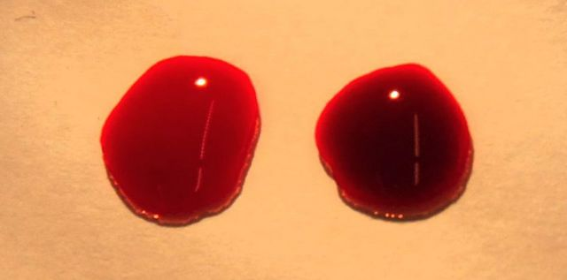
Oxygen Levels
Oxyhemoglobin = plenty of oxygen; “bright red”
Deoxyhemoglobin = low in O2, “dark red”
The blood on the left is oxygenated, the right is deoxygenated blood (from a vein)

Slide 14
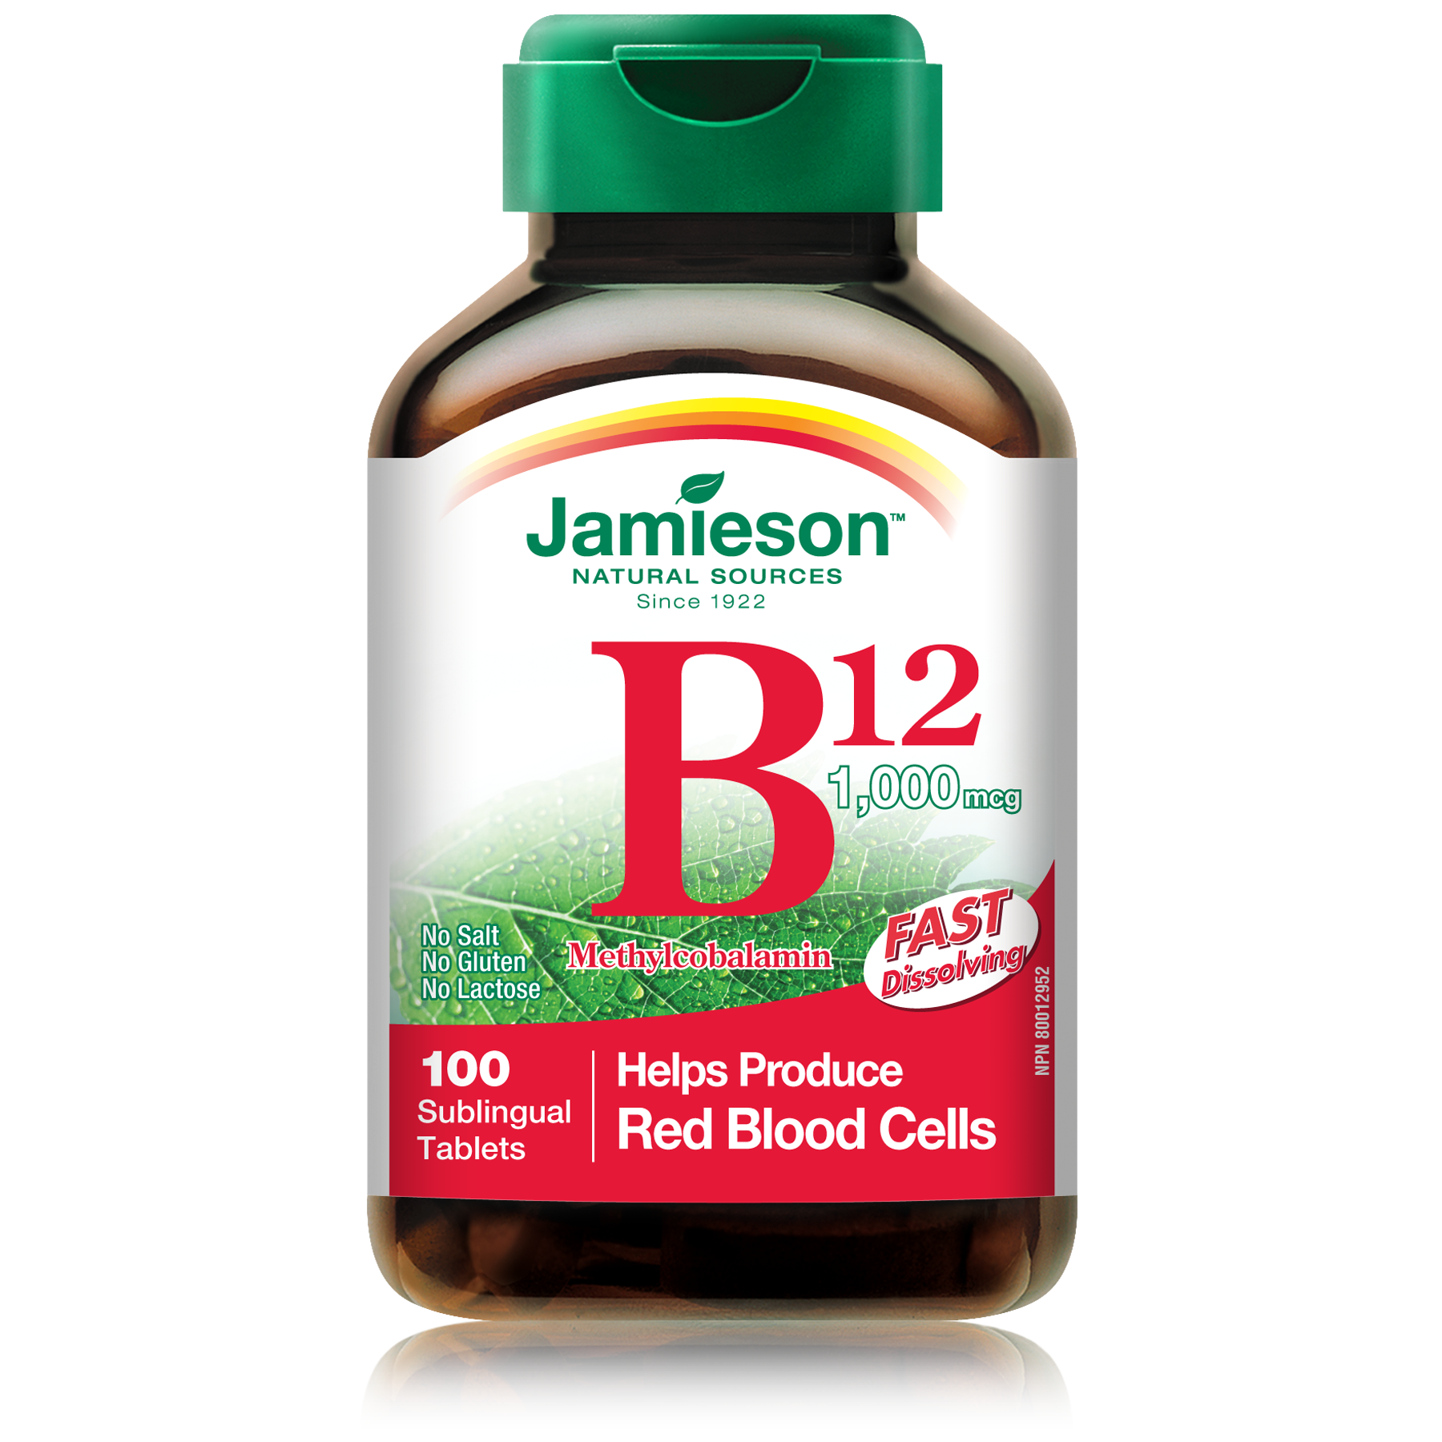
RBC Production
Folic Acid – DNA synthesis
Vitamin B12 – DNA synthesis
Iron – hemoglobin synthesis
Too few RBCs - anemia

Slide 15
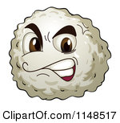
WHITE BLOOD CELLS (Leukocytes)
General function is to protect the body against disease
There are FIVE different kinds of WBCs
Granulocytes (granular cytoplasm)
Neutrophils, Eosinophils, Basophils
Agranulocytes (lacking granular cytoplasm)
Monocytes, Lymphocytes

Slide 16
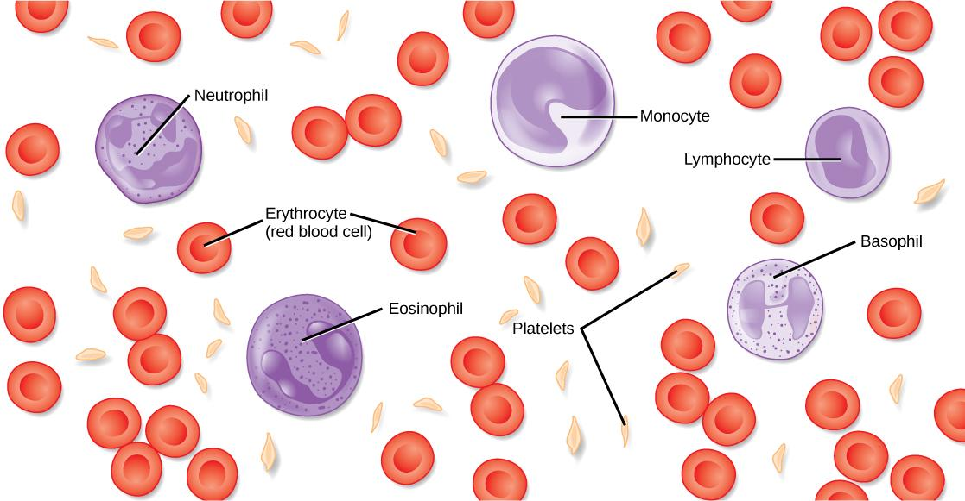
The white blood cells are found within the red blood cells, there are not as many WBC’s and generally, they are larger than RBC’s.

Slide 17
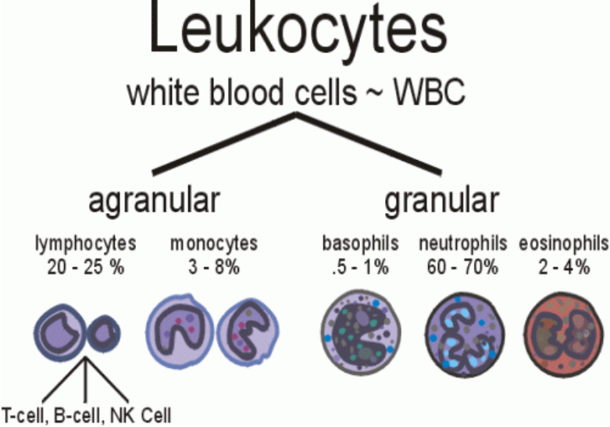

Slide 18
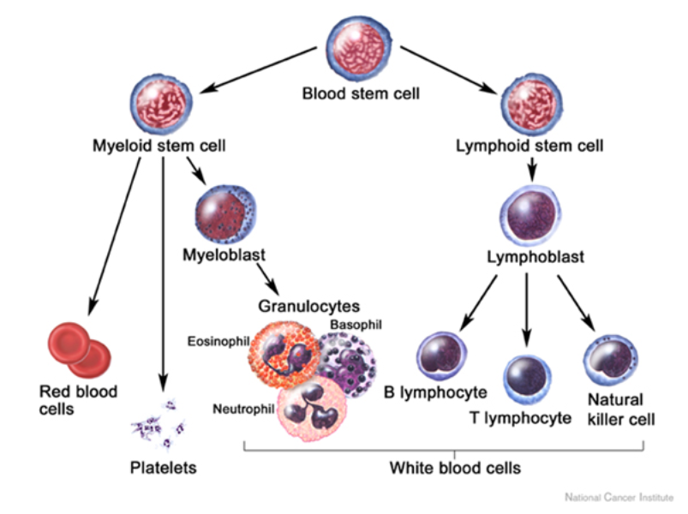

Slide 19
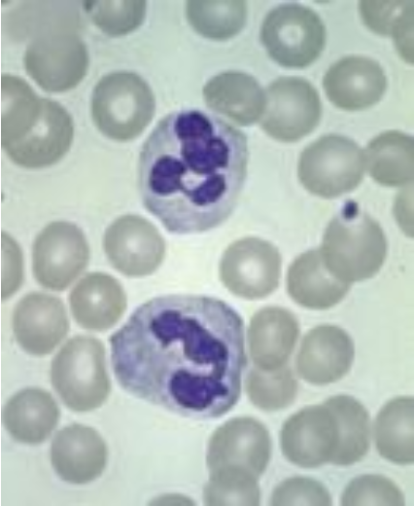
Neutrophil (nucleus has several lobes)
Active phagocytes
60% of WBC
Present in the pus of wounds

Slide 20
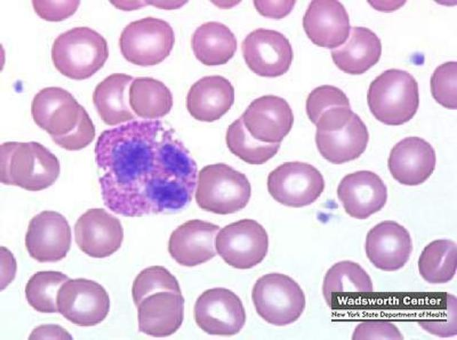
Eosinophil
Mainly attack parasites
2% WBC

Slide 21
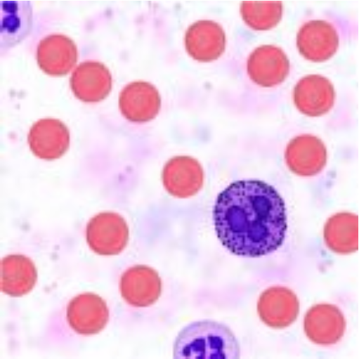
Basophil
Produces
Heparin = blood thinner
Histamines = Important in Inflammatory Reaction
1% WBC

Slide 22
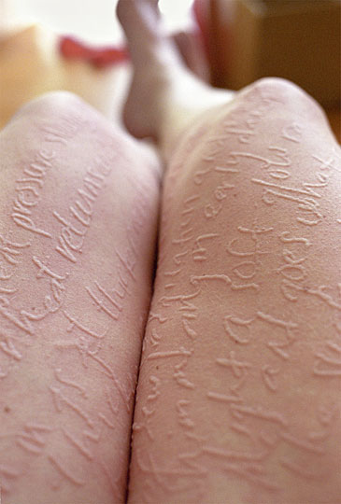
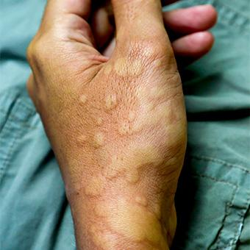
Dermatographia:
Immune system releases excess amounts of histamine causing welts to appear when lightly scratched.
Cold Urticaria (essentially meaning "cold hives") is an where hives or large red welts form on the skin after exposure to a cold stimulus.

Slide 23
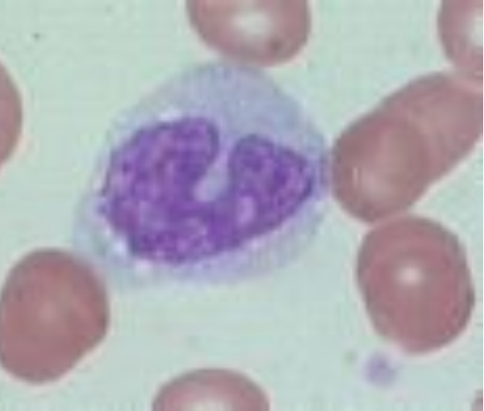
Monocyte
Become macrophages
6% of wbc’s
First line of defense at infection site.
Larger cell with horseshoe shaped nucleus

Slide 24
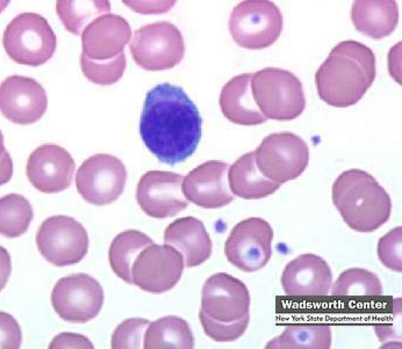
Lymphocyte
Dark nucleus that takes up whole cell
Main defense (immune system)
Produce ANTIBODIES
30% WBC

Slide 26
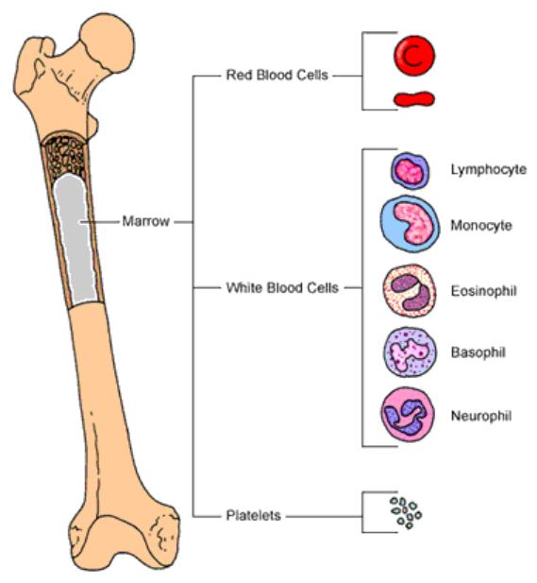

Slide 27
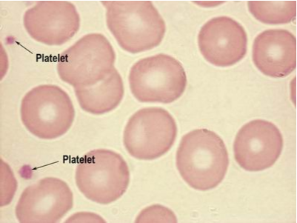
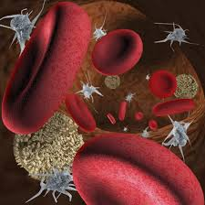
Platelets (thrombocytes)
Blood clots and vessel repair

Slide 28
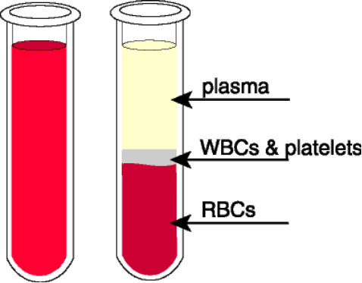
Plasma
The liquid portion of blood is 92% water
Also contains nutrients, gases, vitamins (etc) and plasma proteins

Slide 29
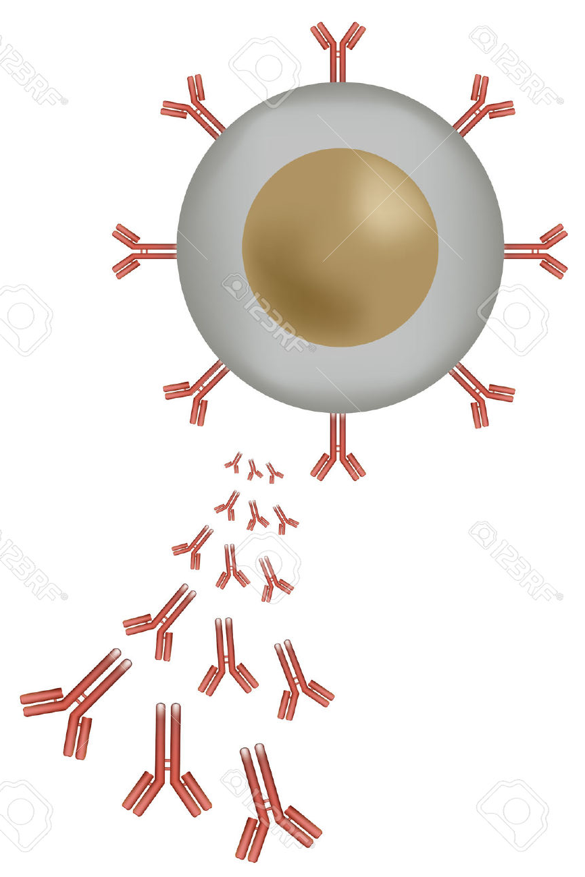
Blood Proteins
Albumins – blood pressure
Globulins – transport lipids and antibodies for immunity
Fibrinogen – important for blood clotting

Slide 30
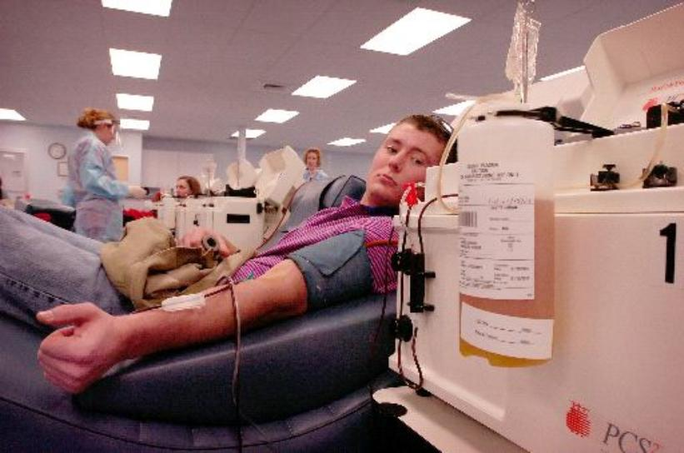

Slide 31
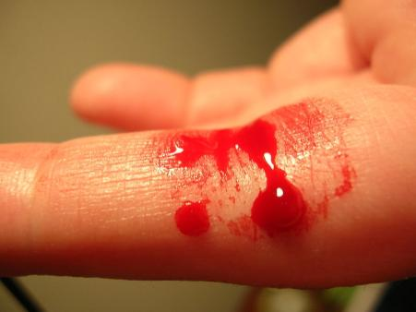
HEMOSTASIS
The process of stopping bleeding
Involves the coagulation and clotting of the blood to seal the site of damage

Slide 32
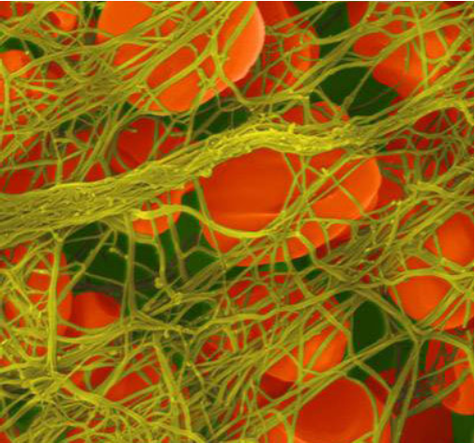
THREE EVENTS IN HEMOSTASIS
1. Blood Vessel Spasm, Seratonin = vasoconstrictor
2. Platelet plug formation = plugs opening
3. Blood coagulation conversion of fibrinogen to fibrin by thrombin

Slide 33
COAGULATION - the thickening of blood to form a clot (hematoma)

Slide 34
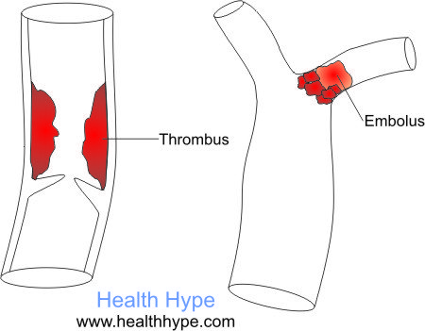
THROMBUS – blood clot (abnormal)
EMBOLUS – when the clot moves to another place.

Slide 35
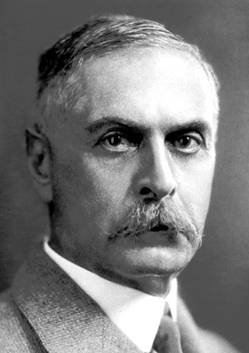
Blood types
1901 - Austrian Karl Landsteiner discovered human blood groups

Slide 36
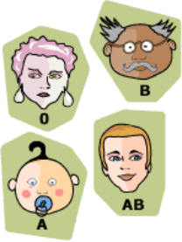
Takes three to tango
Alleles: A, B, O
A & B are codominant
O is recessive

Slide 37
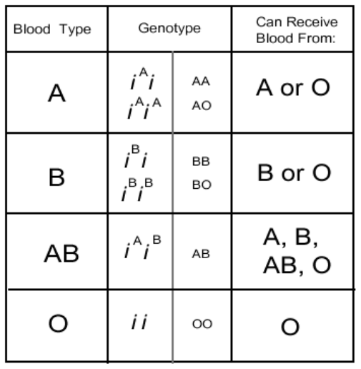
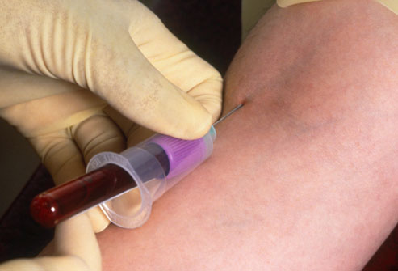
Genotypes

Slide 38
Practice cross
Type A (genotype AA) x Type O (genotype OO)

Slide 39
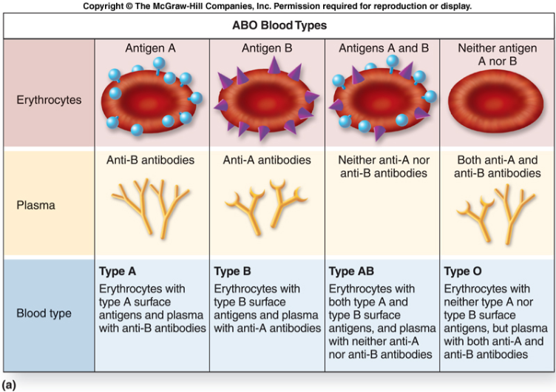

Slide 40
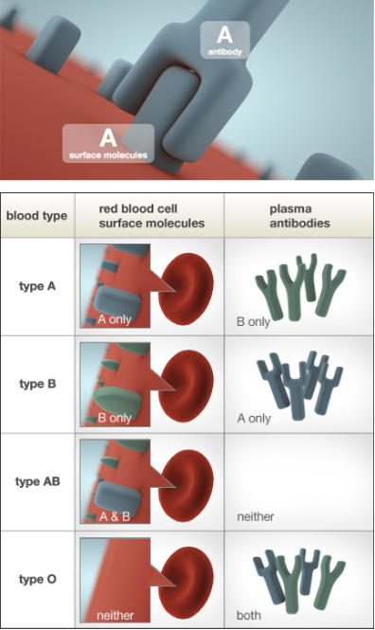
Are you my type?
Blood that has antibodies on it that is not recognized by the body will be attacked by your immune system
AB is the universal acceptor
O is the universal donor

Slide 41
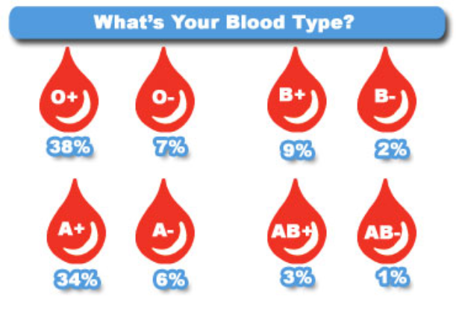
Rh Factor
A person can either be Rh + or Rh –
(positive is dominant)
Problem: When a fetus is Rh+ and the mother is Rh-, this can cause the mother’s immune system to attack the fetus. There are drugs that will suppress this

Slide 42
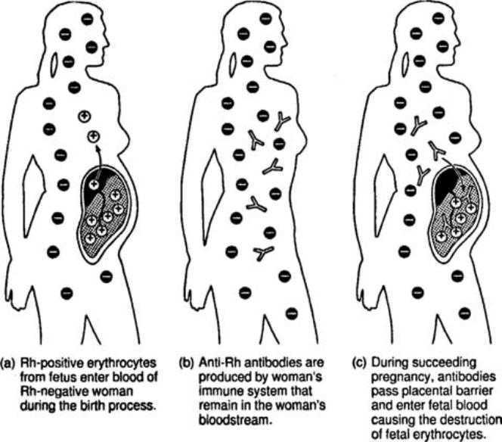

Slide 43
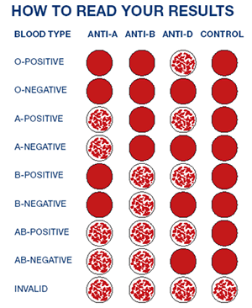
Blood type test

Slide 44
EXAMPLES OF BLOODBORNE PATHOGENS
HEPATITIS B (HBV)
HEPATITIS C (HCV)
Other NON A, NON B HEPATITIS
HUMAN IMMUNODEFICIENCY VIRUS (HIV)
MALARIA
OTHER POTENTIALLY INFECTIOUS MATERIALS

Slide 45
HIV, hepatitis B virus, and hepatitis C virus are the viruses most likely to be transmitted via the following routes in an occupational setting:
needle stick / sharps injuries skin or eye contact mucous membrane and non-intact skin exposure to contaminated blood or other potentially infectious materials ( scratches, cuts, bites, or wounds )

Slide 46
Avoid Contact With Blood
Wear gloves
Dispose of items that have been contaminated (tissues, needles, bandaids) in biohazard containers
Do not “horse around”
Treat every person as if they may be carrying an infectious disease

